Slide 1


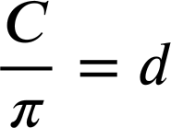
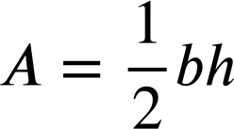
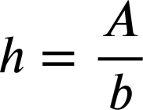
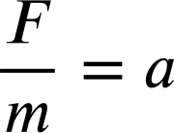




Changing the subject with simple formula
Task A: Identifying the subject of the formula
1) Identify the subject in each of these formula/equations.
a)
b)
c)
d)
e)
f)
g)
h)
2) Aisha is solving the equation 85 − 3x = 17
The equation can be rearranged in these forms:
85 − 3x = 17
85 − 17 = 3x
85 = 17 + 3x
85 = 3x + 17
The form 85 − 17 = 3x is the best rearrangement because 3x is the subject.
You might have written:
Whilst 85 − 17 = 3x is the best form from which to solve we can not call 3x the subject because the coefficient is 3 not 1

Slide 2
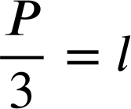
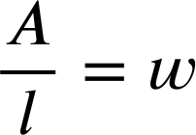
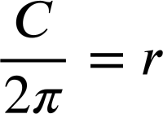
Changing the subject with simple formula
Task B: Changing the subject of simple formula
1) In each equation/formula change the subject as instructed.
a) Make x the subject.
b) Make l the subject.
x − 2.7 = 8.1
P = 3l
x − 2.7 + 2.7 = 8.1 + 2.7
P ÷ 3 = 3× l ÷ 3
x = 8.1 + 2.7
x = 10.8
c) Make y the subject.
d) Make w the subject.
17 − y = 4
A = l × w
17 − y + y = 4 + y
A ÷ l = l × w ÷ l
17 = 4 + y
17 − 4 = 4 + y − 4
17 − 4 = y
13 = y
e) Make u the subject.
f) Make r the subject.
v = u + at
C = 2πr
v − at = u + at − at
C ÷ 2π = 2πr ÷ 2π
v − at = u
2) Rearrange this formula as instructed.
F − E + V = 2
a) Make F the subject.
b) Make V the subject.
c) Make E the subject.
F − E + V = 2
F − E + V = 2
F − E + V = 2
F − E + V + E − V = 2 + E − V
F − E + V + E − F = 2 + E − F
F − E + V + E = 2 + E
F = 2 + E − V
V = 2 + E − F
F + V = 2 + E
F + V − 2 = 2 + E − 2
F + V − 2 = E
Mathematics in Education and Industry
v2.3

